Slide 1
Introduction to Large Scale Databases

Slide 2
COURSE OUTCOMES
C331-3.1 | Infer the background processes involved in queries and transactions, and explain how these impact on database operation and design
C331-3.2 | Choose appropriate ways of storing data and optimize queries.
C331-3.3 | Explain the concept and challenge of big data and demonstrate the comparison of relational database systems with NoSQL databases
C331-3.4 | Compare and discover the suitability of appropriate large databases to manage, store, query, and analyze various form of big data
C331-3.5 | Apply techniques for data fragmentation, replication, and allocation to design a distributed or parallel database system

Slide 3
Module No. | Title of the Module | Topics in the Module
1. | Introduction to large scale Databases | Review of database systems, Data sources and join processing, modelling and query languages
2. | Transaction management | Transaction processing concepts, Concurrency control techniques and protocols
3. | Data Storage and Indexing | Data storage and indexing of massive databases in databases and data warehouses. Introduction to technologies for handling big data
4. | Query processing and Optimization | Measures of query cost, Evaluation of expressions, Query planning, evaluation and optimization
5. | Big data Tools and Technologies | Review of Big data, CAP Theorem (consistency, availability, partition tolerance), Using big data in businesses, Data visualization for data analysis, NoSQL databases
6. | Hadoop and its Ecosystem | Hadoop core components, Hadoop Ecosystem components, Data storage and processing in Hadoop framework
7. | Application-driven databases | Parallel and Distributed databases, Distributed Database Design, Architecture of Distributed DBMS
8. | Advanced databases | Graph databases, spatial and temporal databases

Slide 4
Name some database management systems
MySQ, IBM DB2, MongoDB, SQLite, PostgreSQL, Oracle, MariaDB
Name some database models
A database model shows the logical structure of a database, including the relationships and constraints that determine how data can be stored and accessed.
Hierarchical database model, Relational model, Network model, Object-oriented database model Entity-relationship model. Document model,Star schema.

Slide 5
HISTORY REPEATS ITSELF
Old database issues are still relevant today.
The SQL vs. NoSQL debate is reminiscent of Relational vs. CODASYL (CODASYL, the Conference/Committee on Data Systems Languages,) debate from the 1970s.
Many of the ideas in today’s database systems are not new

Slide 6
1960s CODASYL
COBOL people got together and proposed a standard for how programs will access a database.
Lead by Charles Bachman.
→ Network data model.
Charles Bachmen’s Integrated Data Store (IDS) is said to be the first DBMS in history

Slide 7
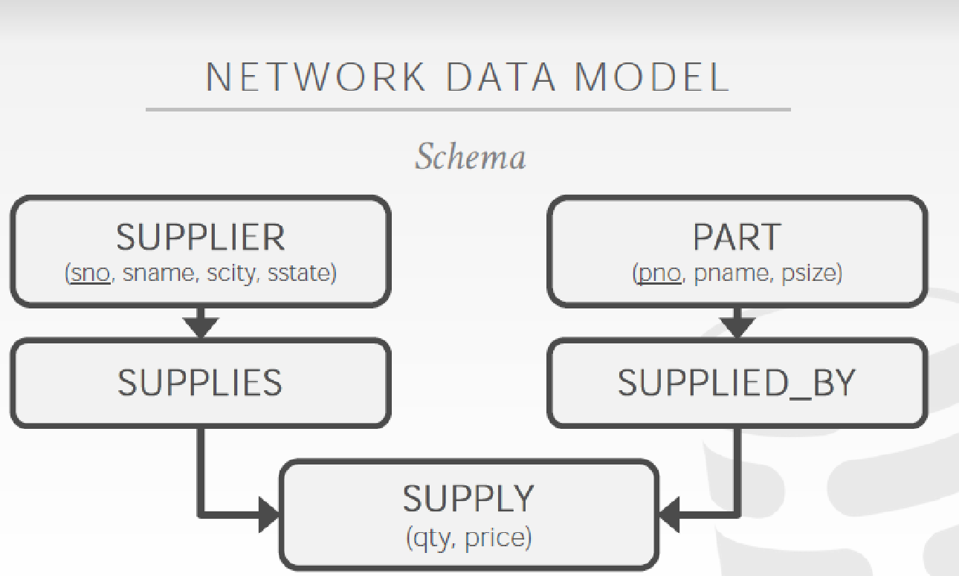
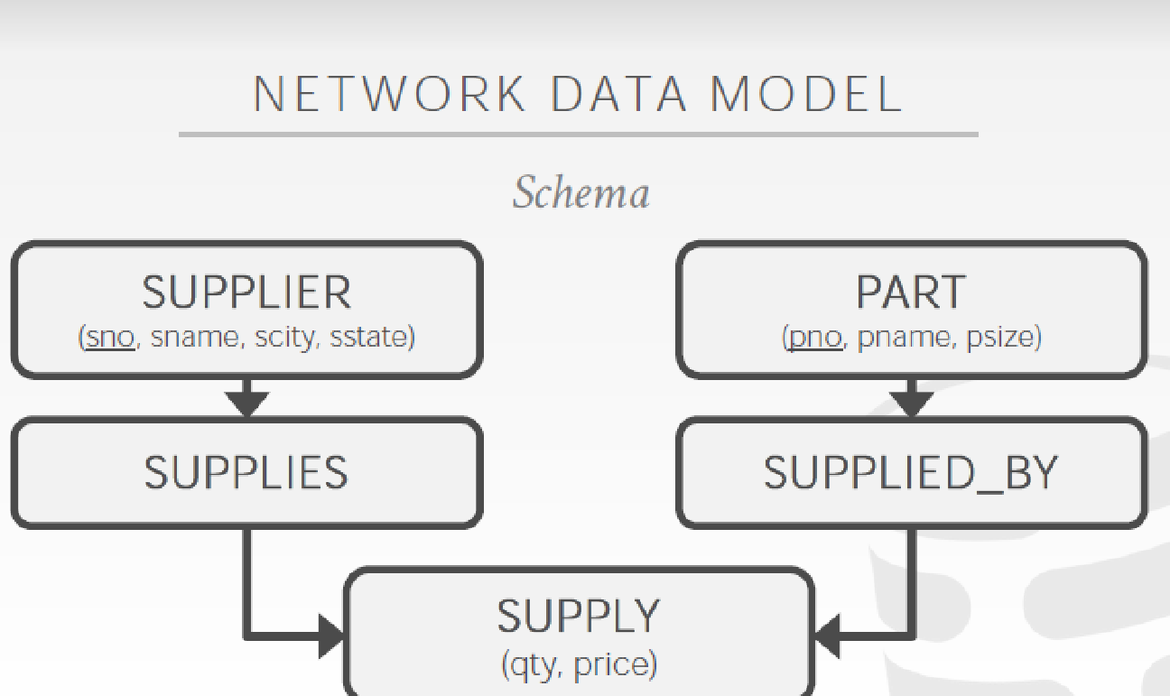
Network Model has Graph like structure

Slide 8
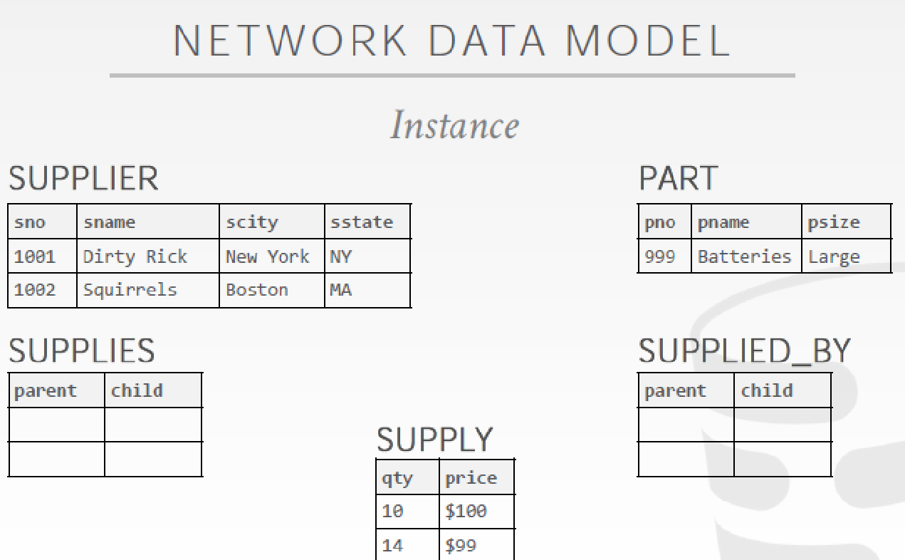

Slide 9
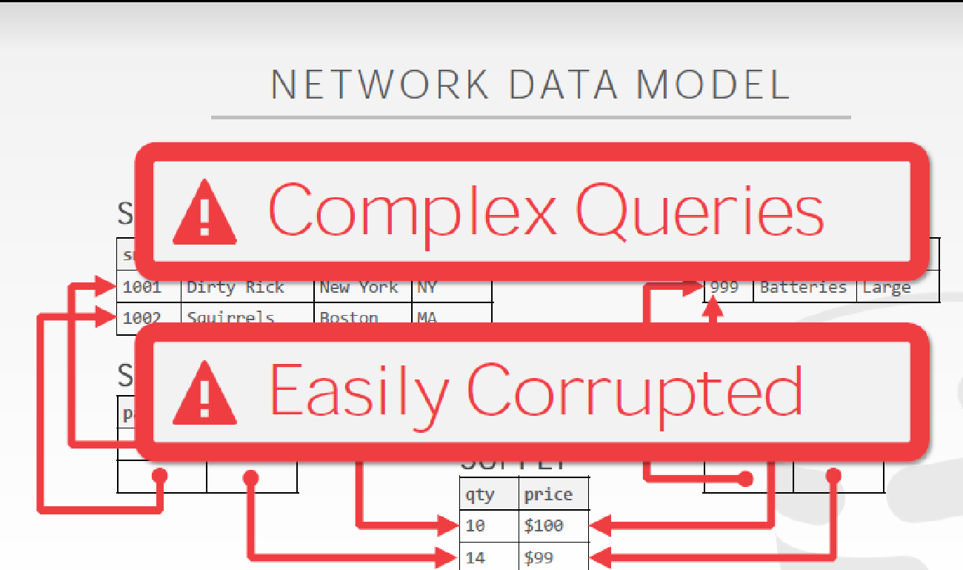

Slide 10
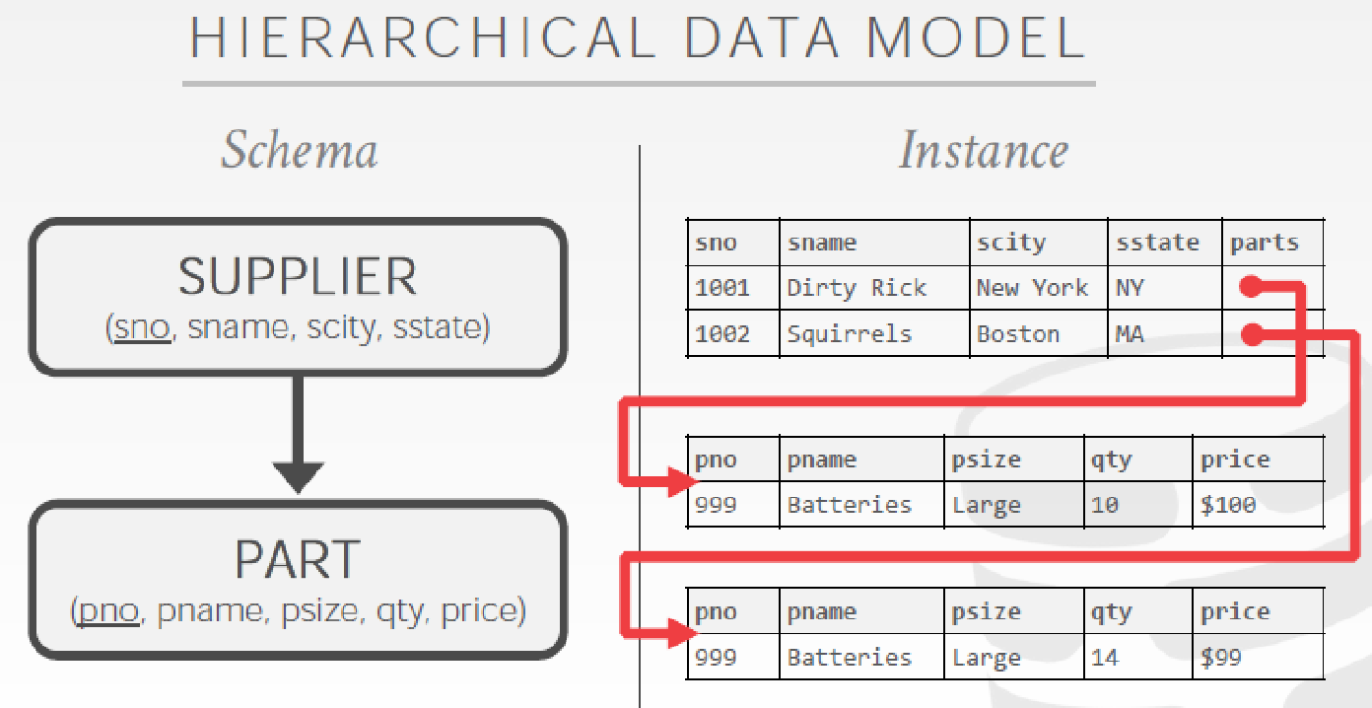

Slide 11
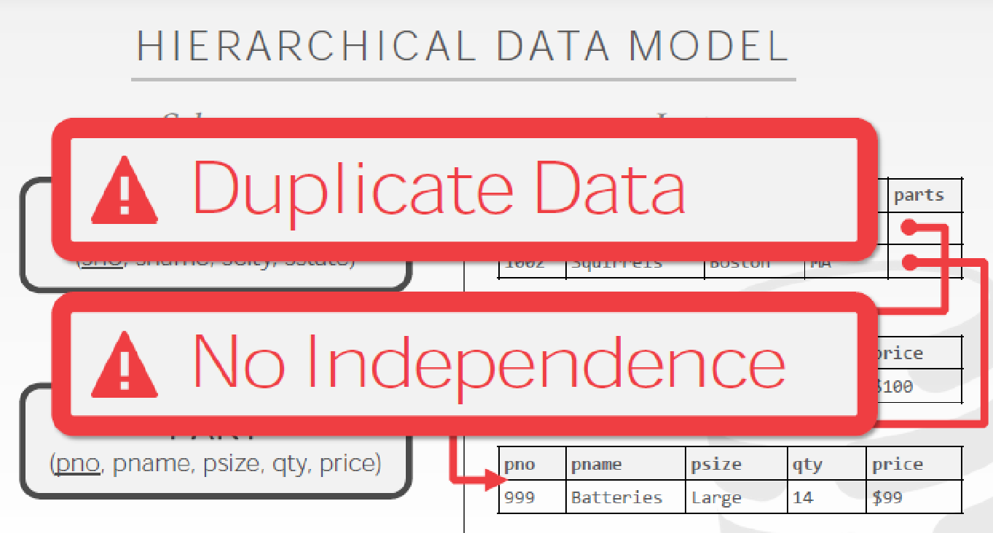
Network Model has tree like structure

Slide 12
1970s RELATIONAL MODEL
Ted Codd was a mathematician working at IBM Research.
He saw developers spending their time rewriting IMS and Codasyl programs every time the database’s schema or layout changed.
Database abstraction to avoid this maintenance:
→Store database in simple data structures.
→Access data through high-level language.
→Physical storage left up to implementation.

Slide 13
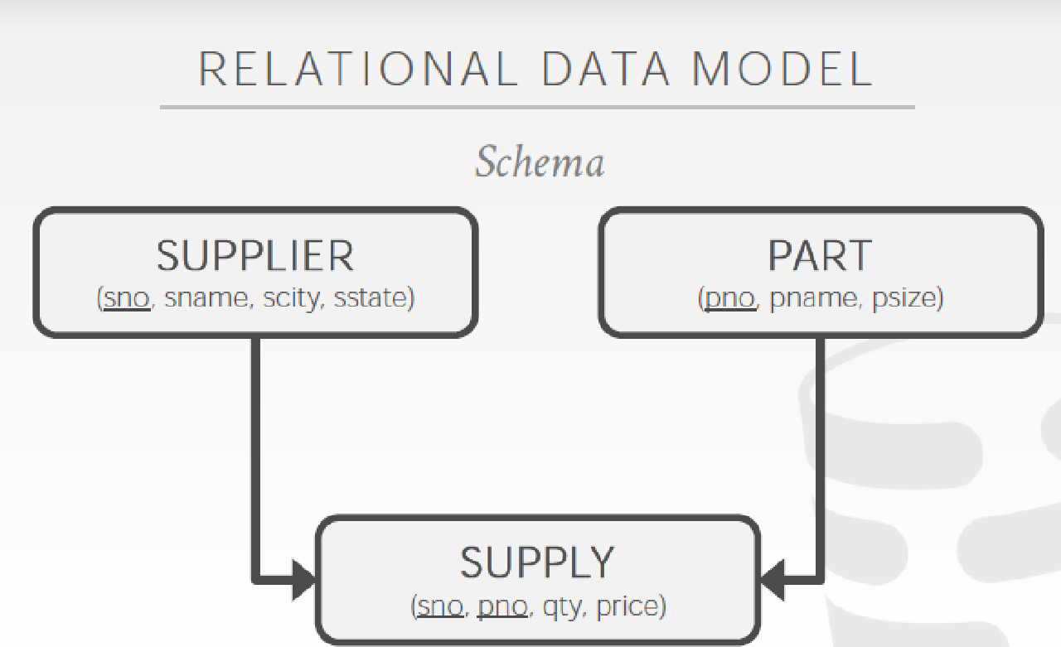

Slide 14
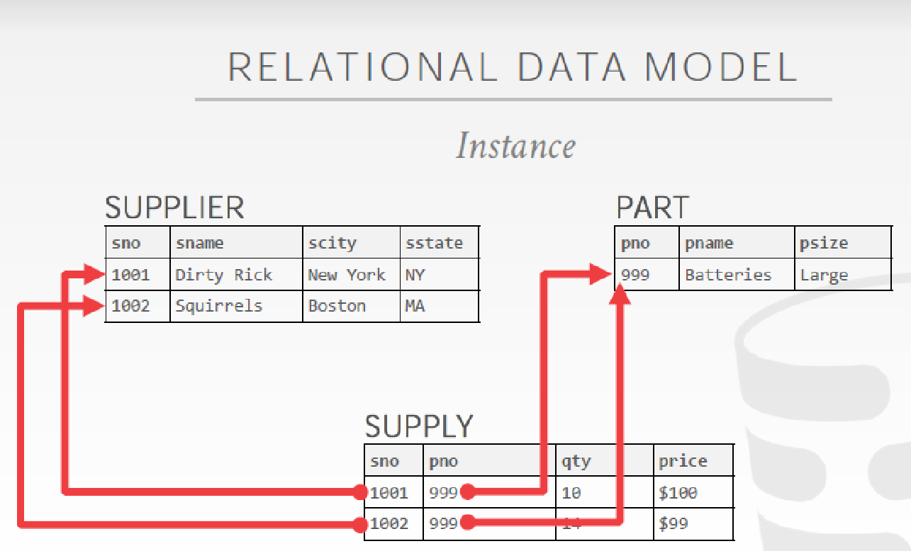

Slide 15
1970s RELATIONAL MODEL
Early implementations of relational DBMS:
→System R–IBM Research
→INGRES–U.C. Berkeley
→Oracle–Larry Ellison
→IBM comes out with DB2 in 1983.
→“SEQUEL” becomes the standard (SQL).
Many new “enterprise” DBMSs but Oracle wins marketplace.
Stonebraker creates Postgres.

Slide 16

1980s OBJECT-ORIENTED DATABASES
Avoid “relational-object impedance mismatch” by tightly coupling objects and database.
Few of these original DBMSs from the 1980s still exist today but many of the technologies exist in other forms (JSON (JavaScript Object Notation);, XML (Extensible Markup Language))
E.g, Versant Object Database or VOD

Slide 17
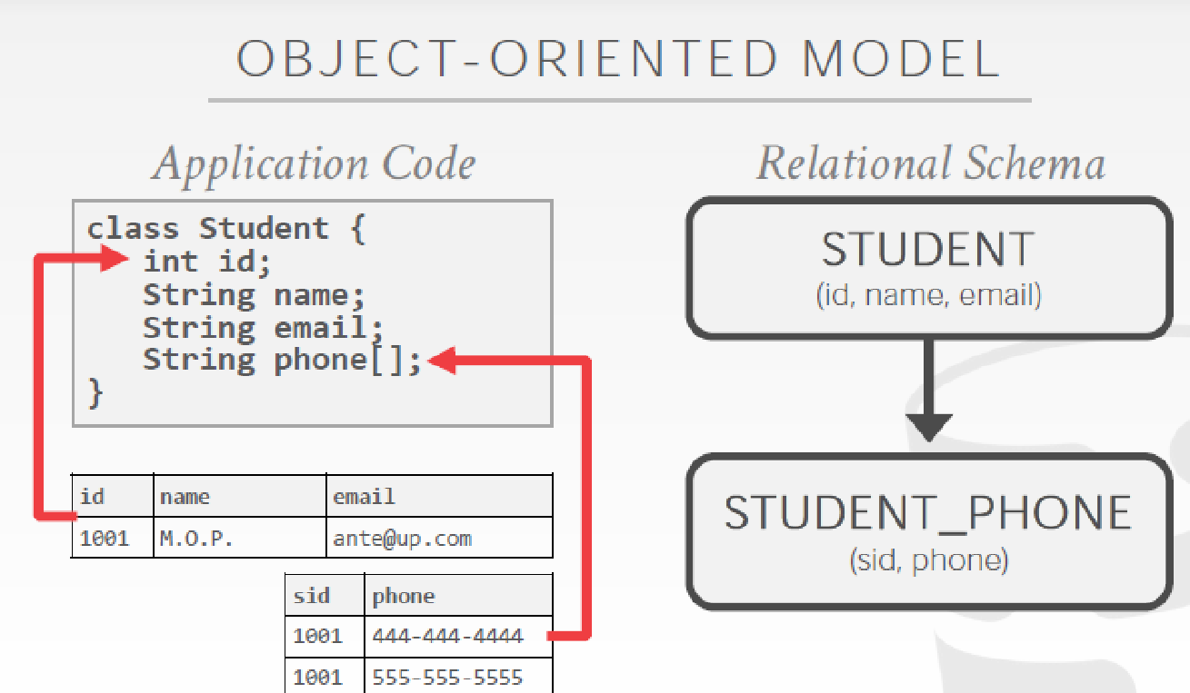

Slide 18
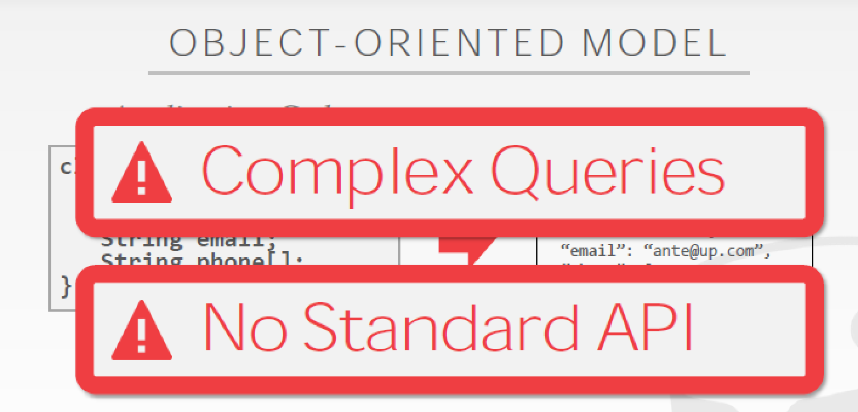

Slide 19
1990s
No major advancements in database systems or application workloads.
→Microsoft forks Sybase and creates SQL Server.
→MySQL is written as a replacement for mSQL.
→Postgres gets SQL support.
→SQLite started in early 2000.

Slide 20
2000s INTERNET BOOM
Many companies wrote their own custom middleware to scale out database across single-node DBMS instances.

Slide 21
Scaling
Client Site
Client Site
Client Site
Load Balancer (Proxy)
App Server
App Server
App Server
App Server
App Server
MySQL Master DB
MySQL Slave DB
Database becomes the Scalability Bottleneck
Cannot leverage elasticity
Replication
Notes:
Elasticity is the degree to which a system can adapt to workload changes by provisioning and deprovisioning resources in an on-demand manner, such that at each point-in-time the available resources match the current demand as closely as possible.

Slide 22
Scaling
Client Site
Client Site
Client Site
Load Balancer (Proxy)
App Server
App Server
App Server
App Server
App Server
MySQL Master DB
Replication
MySQL Slave DB

Slide 23



Scaling
Client Site
Client Site
Client Site
Load Balancer (Proxy)
Apache
+ App Server
Apache
+ App Server
Apache
+ App Server
Apache
+ App Server
Apache
+ App Server
Scalable and Elastic,
but limited consistency and operational flexibility
Key Value Stores

Slide 24

2000s DATA WAREHOUSES
Rise of the special purpose OLAP DBMSs.
→Distributed / Shared-Nothing
→Relational / SQL
→Usually closed-source.

Slide 25
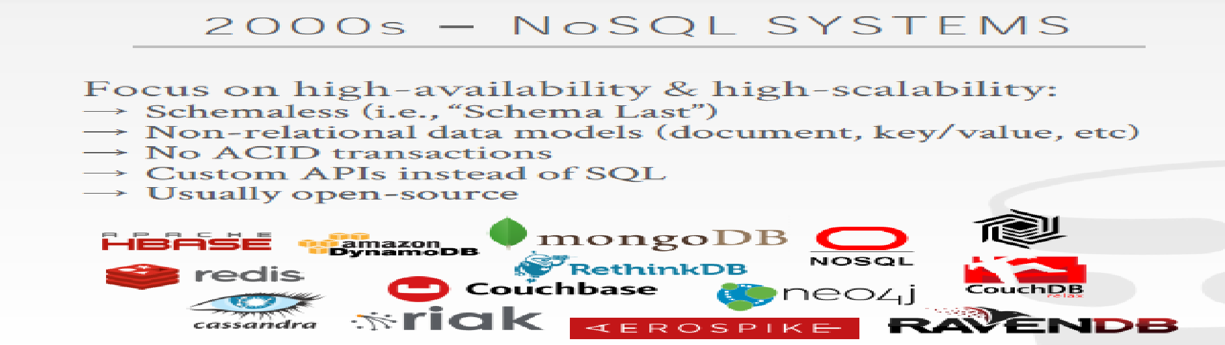
2000s NoSQL SYSTEMS
Focus on high-availability & high-scalability:
→ Schemaless (i.e., “Schema Last”)
→ Non-relational data models (document, key/value, etc)
→ No ACID transactions
→ Custom APIs instead of SQL
→ Usually open-source

Slide 26
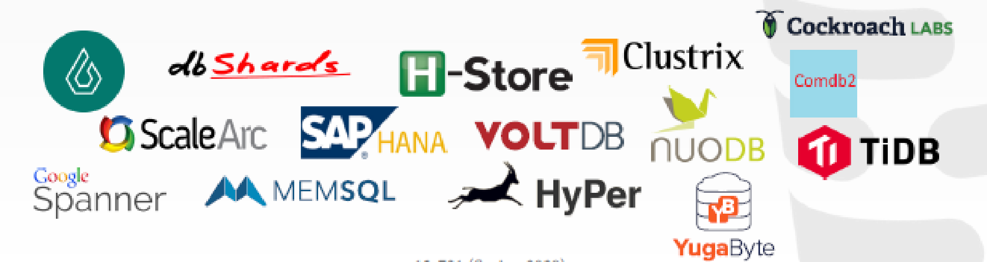
2010s NewSQL
Provide same performance for OLTP workloads as NoSQL DBMSs without giving up ACID:
→Relational / SQL
→Distributed
→Usually closed-source

Slide 27

2010s CLOUD SYSTEMS
First database-as-a-service (DBaaS) offerings were "containerized" versions of existing DBMSs.
There are new DBMSs that are designed from scratch explicitly for running in a cloud environment.

Slide 28

2010s SHARED-DISK ENGINES
Instead of writing a custom storage manager, the DBMS leverages distributed storage.
→Scale execution layer independently of storage.
This is what is referred to as a data lake.

Slide 29
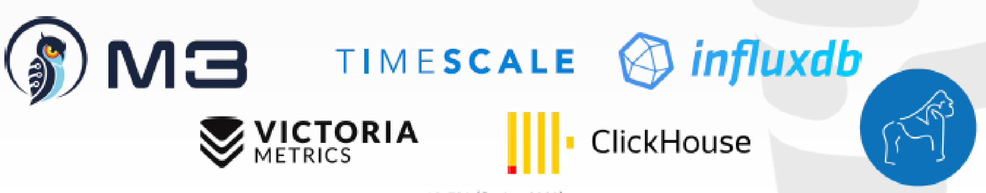
2010s TIMESERIES SYSTEMS
Specialized systems that are designed to store timeseries / event data.
The design of these systems make deep assumptions about the distribution of data and workload query patterns.

Slide 30
2010s SPECIALIZED SYSTEMS
Embedded DBMSs
Multi-Model DBMSs
Blockchain DBMSs
Hardware Acceleration

Slide 31
Another way of Classification
In-memory database or on-disk database
In-memory is a data storage software that holds all of its data in the memory of the host.
The main difference between a traditional database and an in-memory database relies upon where the data is stored.
Even when compared with solid-state drives (SSD), random access memory (RAM) is orders of magnitude faster than disk access.

Slide 32
Another way of Classification
Because an in-memory database uses the RAM for storage,
-> faster access to the data than with a traditional database using disk operations.
On the downside, they are at high risk of losing data in case of a server failure, since the data is not persisted anywhere.
If a server failure or shutdown should occur, everything currently in the memory of that computer would be lost due to the volatile nature of RAM.
The cost of memory is much higher than the cost of hard disks. This makes in-memory databases much more expensive.

Slide 33
Too many choices !
Think of a large e-commerce website.
The information about the products is crucial and should be kept on a persisted storage, but the information in the shopping cart could potentially be kept in an in-memory database for quicker access.

Slide 34
Large Scale or “Big Data”
‘Big-data’ is similar to ‘Small-data’, but bigger
Having data bigger consequently requires different approaches:
techniques, tools & architectures
...to solve:
New problems...
...and old problems in a better way

Slide 35
Big Data Sources
Big Data EveryWhere!
Lots of data is being collected and warehoused
Web data, e-commerce
purchases at department/grocery stores
Bank/Credit Card transactions
Social Network
Tweets stored in a flat file
A collection of image file in a directory
Historical weather observations that are stored as XML files.

Slide 36
Why is “big data” a “big deal”?
Private Sector
Walmart handles more than 1 million customer transactions every hour, which is imported into databases estimated to contain more than 2.5 petabytes of data
Facebook handles 40 billion photos from its user base.
Falcon Credit Card Fraud Detection System protects 2.1 billion active accounts world-wide
Science
Large Synoptic Survey Telescope will generate 140 Terabyte of data every 5 days.
Biomedical computation like decoding human Genome & personalized medicine
Social science revolution
-…

Slide 37
Volume of data
Bytes
KiloBytes 2¹⁰
MegaBytes 2²⁰
GigaBytes 2³⁰
TeraBytes 2⁴⁰
PetaBytes 2⁵⁰
ExaBytes… ZettaBytes…YottaBytes!!

Slide 38
1st Character of Big data Volume
Scientific and research experiments, such as the Large Hadron Collider (LHC) generates 15 PB a year
Sensors such as GPS sensors, RFIDs, smart meters
Social media such as Facebook and Twitter
Facebook has 2.5 PB of user data + 15 TB/day
Google processes 20 PB a day

Slide 39
Velocity of data
Velocity refers to the speed at which data is processed
Batch
Real Time
Streams

Slide 40
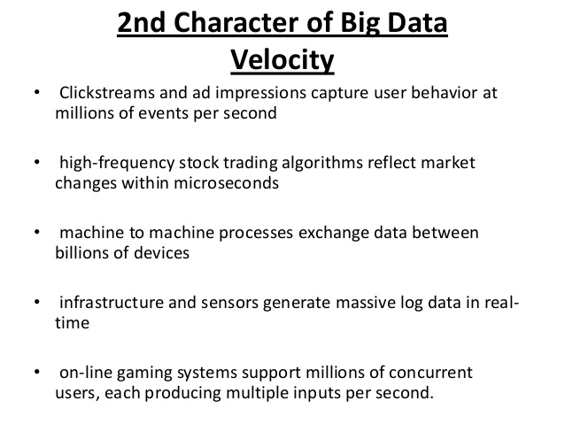

Slide 41
Variety
Variety includes different types of data
Structured
Unstructured
Semi structured
All of the above

Slide 42
Variety
Structured : It own a dedicated Data model, well defined structure, consistent ordered and easily accessible to person and computer. e.g, RDBMS (Relational Database Management Systems)
Semi-Structured: It inherits a few properties of Structured Data, but the major part of this kind of data fails to have a definite structure and also, it does not have the formal structure of data models such as an RDBMS. e.g, XML file.
Unstructured : Does not have any consistent format, formal structure and data is found to varying all the time . e.g images and audio files etc.

Slide 43
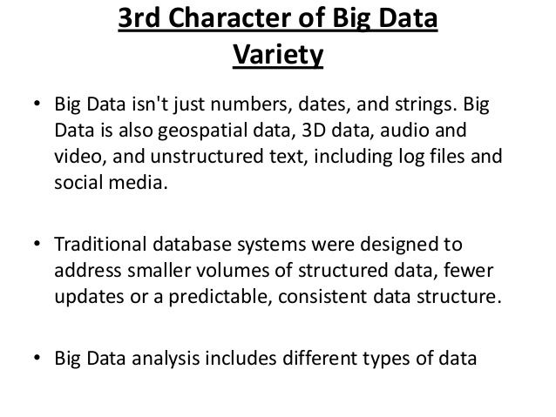

Slide 44
Veracity
Veracity is the quality or trustworthiness of the data. Just how accurate is all this data?
Data that is acquired in a controlled environment, for example via online customer registration, usually contain less noise than data acquired via uncontrolled sources such as blog postings.
Data that enters Big data environments needs to be assessed for quality, which can lead to data processing activities to resolve invalid data and remove noise.

Slide 45
What is “big data”?
"Big Data are high-volume, high-velocity, and/or high-variety information assets that require new forms of processing to enable enhanced decision making, insight discovery and process optimization” (Gartner 2012)
Complicated (intelligent) analysis of data may make a small data “appear” to be “big”
Bottom line: Any data that exceeds our current capability of processing can be regarded as “big”

Slide 46
The Power of Big data
Big Data can bring “big values ” to our life in almost every aspects.
Technologically, Big Data is bringing about changes in our lives because it allows diverse and heterogeneous data to be fully integrated and analyzed to help us make decisions
Today, with the Big Data technology, thousands of data from seemingly
unrelated areas can help support important decisions
This is the power of Big Data.
Areas of Applications
Health and Well being
Policy making and public opinions
Smart cities and more efficient society
New online educational models: MOOC and Student-Teacher modeling
Robotics and human-robot interaction
Much of this power hinges on Research on Analytics

Slide 47
Analysis of Large Scale data
Interdisciplinary endeavour that blends mathematics, statistics, computer science and subject matter expertise

Slide 48
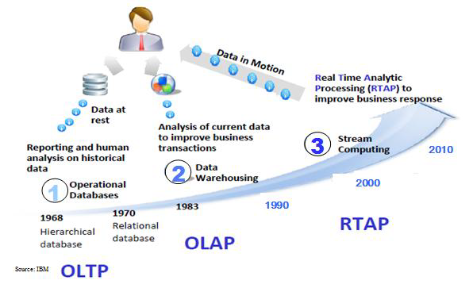
Harnessing Big Data: Analytics
OLTP: Online Transaction Processing (DBMSs)
OLAP: Online Analytical Processing (Data Warehousing)
RTAP: Real-Time Analytics Processing (Big Data Architecture & technology

Slide 49
Lifecycle of Data: 4 “A”s
Scattered
Data
Aggregation
Integrated
Data
Acquisition
Analysis
Log data
Knowledge
Application

Slide 50
What Technologies Do We Have To Tackle Big Data Challenges??

Slide 51
TOP 10 Open Source Big Data Databases
1. Cassandra
Originally developed by Facebook, this NoSQL database is now managed by the Apache Foundation. It’s used by many organizations with large, active datasets, including Netflix, Twitter, Urban Airship, Constant Contact, Reddit, Cisco and Digg. Commercial support and services are available through third-party vendors. Operating System: OS Independent.
2. HBase
Another Apache project, HBase is the non-relational data store for Hadoop. Features include linear and modular scalability, strictly consistent reads and writes, automatic failover support and much more. Operating System: OS Independent.
3. MongoDB
MongoDB was designed to support humongous databases. It’s a NoSQL database with document-oriented storage, full index support, replication and high availability, and more. Commercial support is available through 10gen. Operating system: Windows, Linux, OS X, Solaris.
4. Neo4j
The “world’s leading graph database,” Neo4j boasts performance improvements up to 1000x or more versus relational databases. Interested organizations can purchase advanced or enterprise versions from Neo Technology. Operating System: Windows, Linux.

Slide 52
TOP 10 Open Source Big Data Databases
5. CouchDB
Designed for the Web, CouchDB stores data in JSON documents that you can access via the Web or query using JavaScript. It offers distributed scaling with fault-tolerant storage. Operating system: Windows, Linux, OS X, Android.
6. OrientDB
This NoSQL database can store up to 150,000 documents per second and can load graphs in just milliseconds. It combines the flexibility of document databases with the power of graph databases, while supporting features such as ACID transactions, fast indexes
7. Terrstore
Based on Terracotta, Terrastore boasts “advanced scalability and elasticity features without sacrificing consistency.” It supports custom data partitioning, event processing, push-down predicates, range queries, map/reduce querying and processing and server-side update functions. Operating System: OS Independent.
8. FlockDB
Best known as Twitter’s database, FlockDB was designed to store social graphs (i.e., who is following whom and who is blocking whom). It offers horizontal scaling and very fast reads and writes. Operating System: OS Independent.

Slide 53
TOP 10 Open Source Big Data Databases
9. Hibari
Used by many telecom companies, Hibari is a key-value, big data store with strong consistency, high availability and fast performance. Support is available through Gemini Mobile. Operating System: OS Independent.
10. Riak
Riak humbly claims to be “the most powerful open-source, distributed database you’ll ever put into production.” Users include Comcast, Yammer, Voxer, Boeing, SEOMoz, Joyent, Kiip.me, DotCloud, Formspring, the Danish Government and many others. Operating System: Linux, OS X.

